Slide 1
More prosperity, new jobs: A business perspective on Circular Economy policy Arthur ten Wolde Manager Public Affairs Circular Economy Sustainable Business Association De Groene Zaak Make Resources Count Poznan, Poland, 27 October 2015

Slide 2
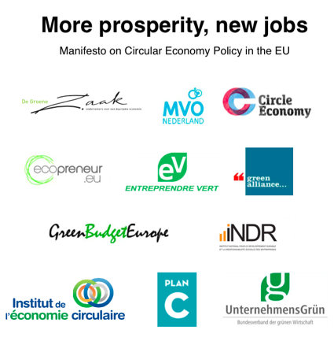
Supported by

Slide 3
Huge opportunities
Up to € 600 billion per year in the EU (€ 4 trillion globally)
3 million jobs by 2030
Waste reduction and reduced environmental impact

Slide 4
The need for government policies
Government policies are needed accelerate and mainstream the circular economy
Remove existing obstacles
Improve the ‘rules of the game’ of our economy in a systems approach

Slide 5
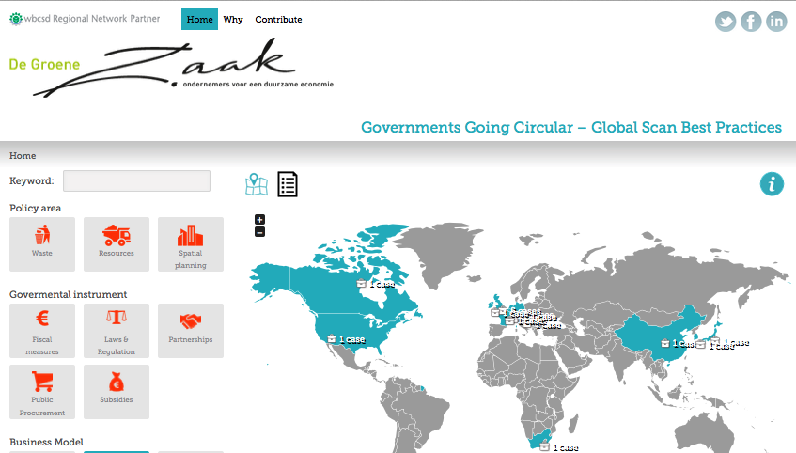
www.govsgocircular.com

Slide 6
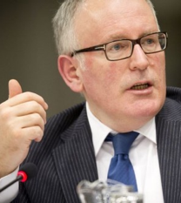
What we ask: (1) Strong government policies
Extend binding targets to cover the full chain (reuse, repair etc.)
Use EU-wide legislation, harmonisation, national action plans, Green Deals and guidelines for member states

Slide 7
What we ask: (2) Financial incentives
Introduce financial incentives for companies and consumers to favour circular business models:
Implement Green Public Procurement
Taxation: - Allow for VAT differentiation - Tax shift from labour to resources (Green Deal)
Extended Producer Responsibility 2.0

Slide 8
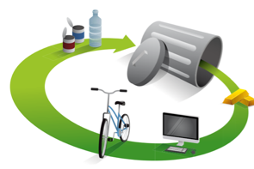
What we ask: (2) Adapt and exploit existing measures, including:
Extend Ecodesign Directive to Circular Design
Horizon 2020 and the Eco-Innovation Programme, including calls for change of the system (economic mechanism design) and an EU Institute for Circular Economy
Programmes for frontrunners, sectors and cross sectoral

Slide 9
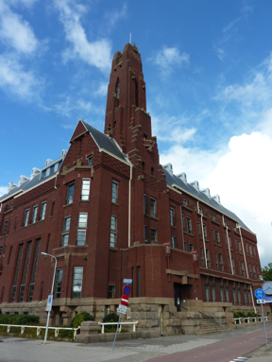
Thank you
For the Manifesto see http://degroenezaak.com/wp-content/uploads/2015/05/Circular-Economy-Package-Manifesto-20-5-2015.pdf
For more information please contact:
Arthur ten Wolde
arthur.ten.wolde@degroenezaak.com
De Groene Zaak
Spaces Den Haag / Rode Olifant
Zuid-Hollandlaan 7
2596 AL THE HAGUE
THE NETHERLANDS

